Slide 1

FIREFLINK Test Automation.Redefined
Scriptless AI Based NLP based Automation Solution

Slide 2
Agenda
Introduction to HTML
  What is HTML?
  Types HTML Tags
  What are Locators?
  How to Identify “Web Elements”.

Slide 3
What is HTML?
  HTML stands for Hyper Text Markup Language
  HTML is the standard markup language for creating Web pages
  HTML describes the structure of a Web page
  HTML consists of a series of elements
  HTML elements tell the browser how to display the content
  Example:
  <html>
  <head>
  <title>Page Title</title>
  </head>
  <body>
  <h1>My First Heading</h1>
  <p>My first paragraph.</p>
  </body>
  </html>

Slide 4
What is an Element in HTML?
An HTML element is defined by a start tag, some content, and an end tag.
<tagname> text , contents </tagname>
1)Tag name = Anything written with in <> .
2)Attribute = it is name value pair within the tag.
3)Attribute name = Key name.
4)Attribute value = Key value.
5)Text = anything written in between tags.
Example: <html>
<label>testID</label>
<input type=“text”>
<button> Submit</button>
        </html>

Slide 5
Types of HTML Tags:
1)Html
2)Head
3)Title
4)Body
5)Form
6)label, etc.
Types of Attributes:
1)ID
2)Name
3)Class
4)Type , etc.

Slide 6
What are Locators ?
Locators are used to identify the elements in website.
Types of locators:
1)id.
2)Name.
3)Class Name.
4)link text.
5)partial Link text.
6)Xpath.
7)tag name.
Example Website:
http://omayo.blogspot.com/

Slide 7
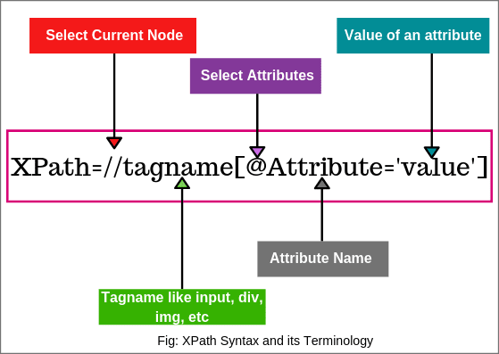
Syntax

Slide 8
  Thank you

